Slide 1
DEERUPT
HACKATON 2018

Slide 2
What?
Release your inner pro
1.
Make every person feel like an athlete by allowing them to earn exclusive content after fulfilling challenges. This content will be custom fitted to the needs of the client based on their data.
2.
The data we gather throughout their challenges will then be used to personalize their shopping experience. The system has to forecast why the user is coming to the website.

Slide 3
Why?
Release your inner pro
1.
Give access to an exclusive sneaker which only can be bought by putting in the work.. Making it feel unique and rewarding.
2.
Content based on your personal habits, which enhances the chance of buying adidas gear.
3.
By doing this we challenge the user to interact more with adidas, creating a a win win for both adidas and the user.

Slide 4
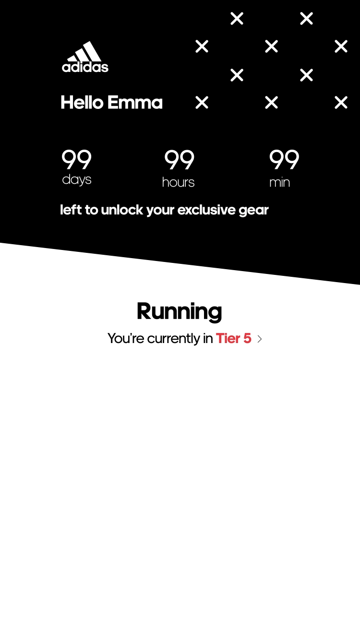
Demo
Release your inner pro
1.
Dashboard
Personalized content on a daily basis
Timer
Swipe between interests

Slide 5
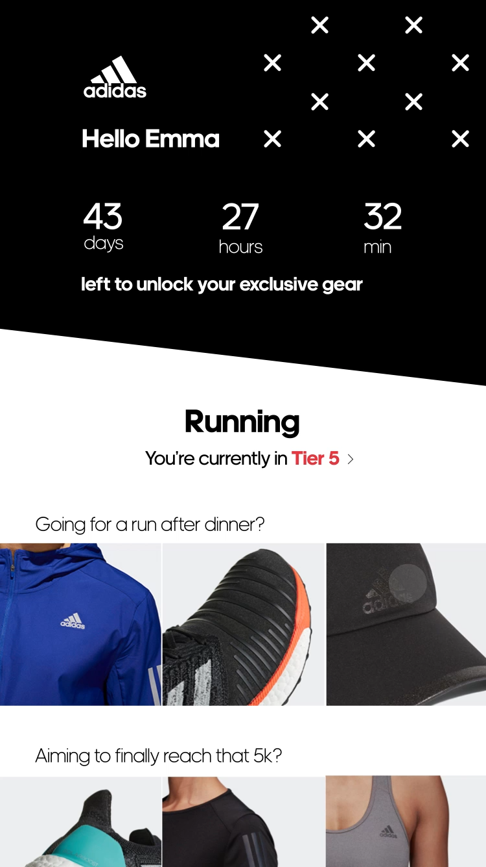
Demo
Release your inner pro
2.
Tiers and challenges
Progress per sport
Rewards based on progress and needs
Mysterious final reward

Slide 6
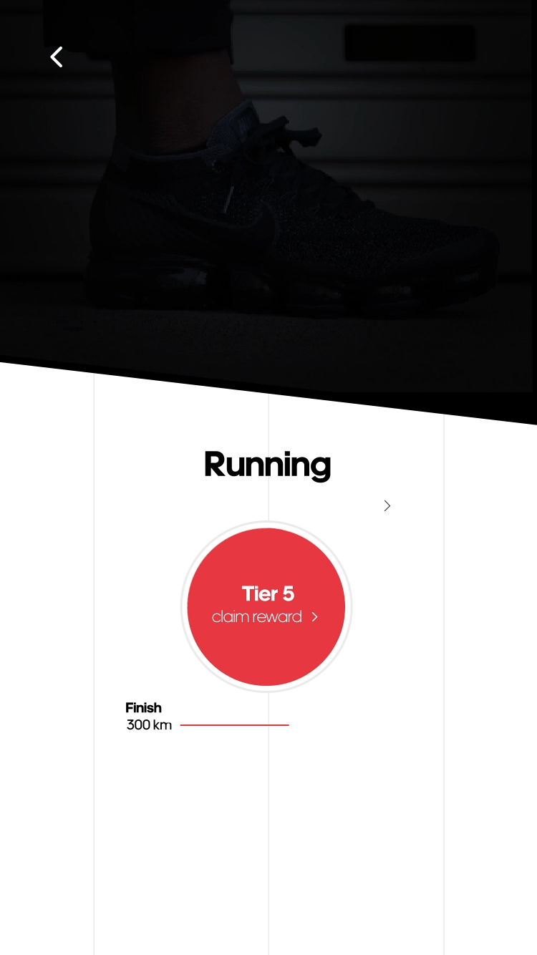
Demo
Release your inner pro
3.
Rewards
Start small (e.g. free shipping, stickers)
Progress.
Final reward is an exclusive sneaker that only people who completed the whole challenge are able to buy.
Based on the clients data collected throughout the process.

Slide 7

But how?
Release your inner pro
1.
Getting to know you by accessing runtastic API.
Use machine learning to recognize your daily patterns and provide you with fitted content on a daily basis.
2.

Slide 8
Questions?

